Slide 1
5.Create and Present an ER Diagram for an Online Library System, Explaining Each Component Clearly.
Introduction to ER Diagram
An Entity Relationship (ER) Diagram is a graphical representation of a database.
It shows entities, attributes, and relationships between data.
ER diagrams help in designing databases before implementation.
They provide a clear understanding of the database structure.
ER diagrams are widely used in software and database development.

Slide 2
Components of an ER Diagram
Main Components
Entity: Represents a real-world object (e.g., Book, Member).
Attribute: Describes the properties of an entity (e.g., Book ID, Name).
Relationship: Shows how entities are connected (e.g., Member borrows Book).
Primary Key: A unique identifier for each entity (e.g., Book_ID).
Cardinality: Defines the relationship between entities (One-to-One, One-to-Many, Many-to-Many).

Slide 3
Entities and Attributes in Online Library System
Book
Book ID (Primary Key)
Title
Author
Publisher
Category
Member
Member ID (Primary Key)
Name
Department
Phone Number
Email

Slide 4
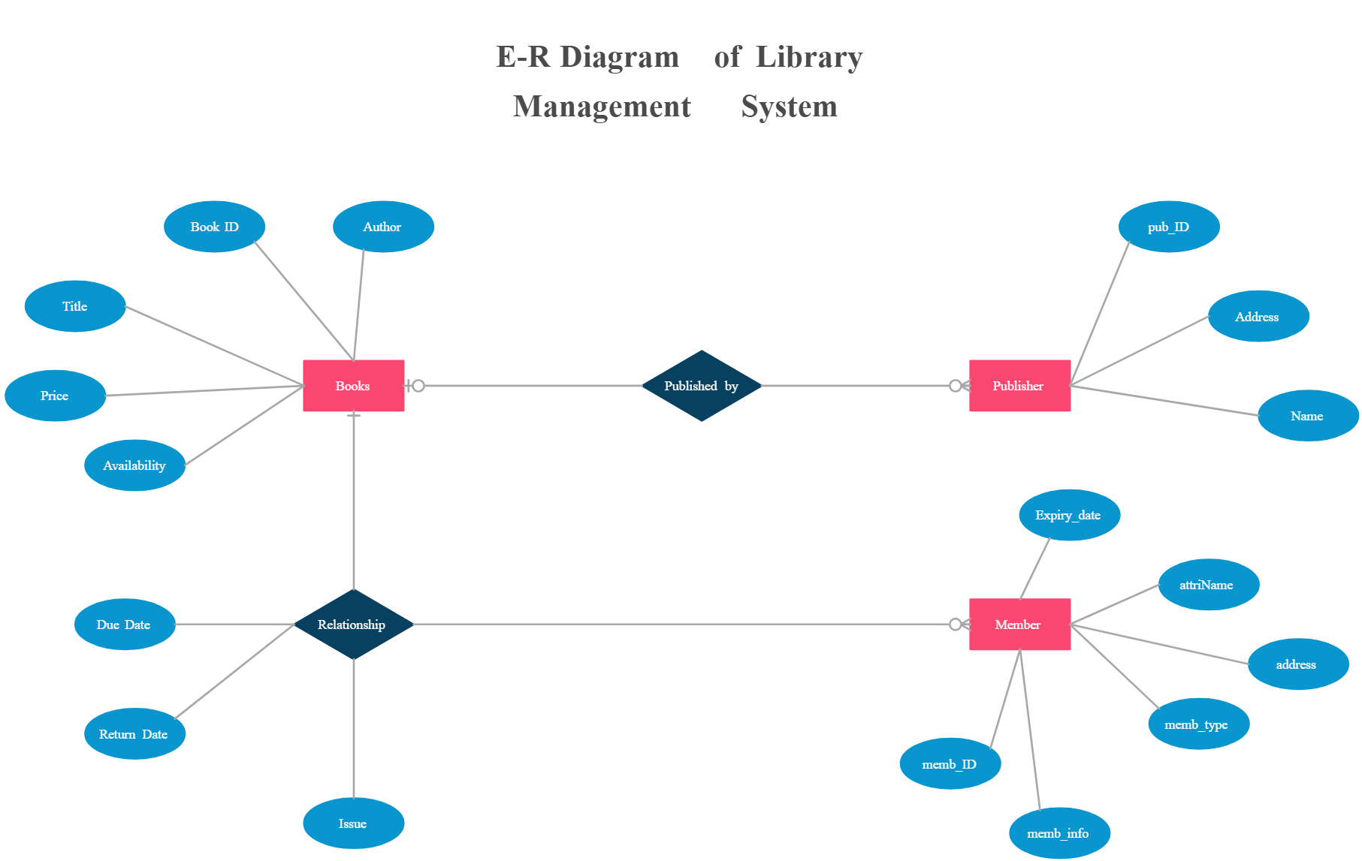
ER Diagram of Online Library System

Slide 5
Explanation of the ER Diagram
Book stores all information about books available in the library.
Member stores student or faculty details.
Librarian manages books and library operations.
Borrow records the issue and return details of books.
Relationships connect members, books, and librarians for efficient library management.

Slide 6
Advantages of ER Diagram
Provides a clear visual representation of the database.
Helps identify relationships between entities.
Reduces database design errors.
Simplifies communication between developers and users.
Makes database implementation easier and more efficient.

